Slide 1

Red Wine Quality Prediction
Capstone Project Submission
(SCTP) ASSOCIATE DATA ANALYST: CAPSTONE PROJECT – PROJECTS
MR TEO KIM SONG - VLC-SCADF11-25-0655 01/08/2025 - 21/08/2025

Slide 2
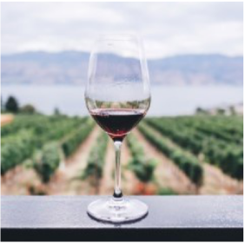
Problem Statement
Client/Scenario: A Portuguese winery wants to improve wine quality control.
Business Problem: Current quality evaluation is manual, costly, and subjective.
Project Objective: Build a data-driven model to predict wine quality based on chemical tests.

Slide 3
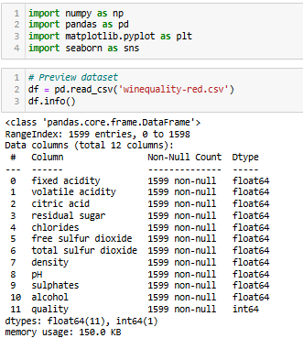
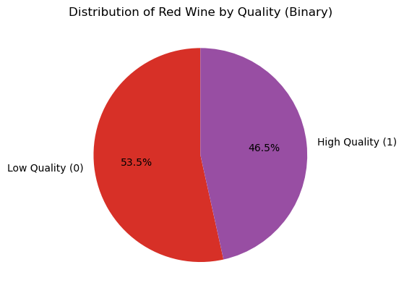
Dataset Overview
Source: UCI Machine Learning Repository – Wine Quality Dataset
Source: UCI Machine Learning Repository – Wine Quality Dataset
Total Records: 1,599 red wine samples
Features: 11 physicochemical properties (e.g., alcohol, acidity)
Target Variable: Wine quality score (0–10), rated by human testers
Data Format: Clean and complete – no missing values
Binary Classification: Quality transformed to:
0 = Low (quality < 6)
1 = High (quality ≥ 6)
Pie Chart shows percentage of High vs. Low quality wines

Slide 4
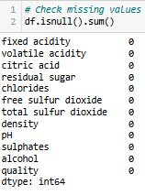
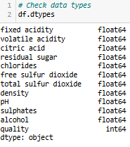
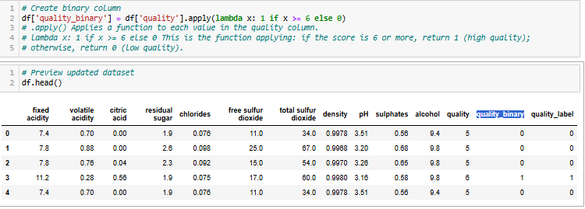
Data Cleaning & Preparation
No missing values found
Corrected data types (all numerical features)
Created a new column: quality_binary
0 = Low quality (score ≤ 5)
1 = High quality (score ≥ 6)
Ready for modeling and visualization
Rounded float values (e.g., chlorides, density) to 4 decimal places for clarity

Slide 5

Feature Engineering
Created binary target variable:
0 → Low quality wine (score ≤ 5)
1 → High quality wine (score ≥ 6)
This simplifies modeling as binary classification.
Distribution of Red Wine by Quality Category (quality binary)
How many red wines are classified as low quality (0) vs high quality (1) after converting the original quality column into binary.
This pie chart visualizes the proportion of red wine samples classified as low quality (0) and high quality (1) based on the quality_binary column.

Slide 6
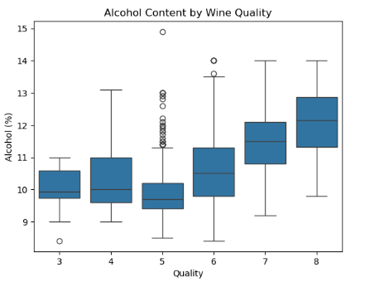
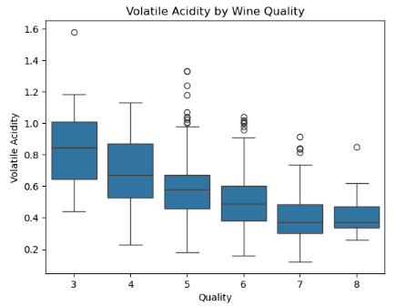
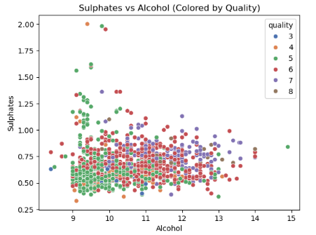


Exploratory Data Analysis (EDA)
Alcohol vs Quality (boxplot)
Volatile Acidity vs Quality (boxplot)
Sulphates and Alcohol (scatter plot)

Slide 7
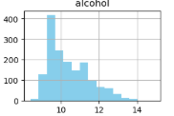
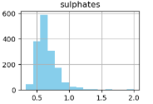
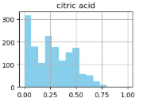
Business Recommendations
Focus on optimizing alcohol, sulphates, and citric acid levels.
Minimize volatile acidity to improve quality.
Use model predictions for early quality control in production.
Future work: Multi-class prediction, more features, and model comparison.

Slide 8






Tools Used / Acknowledgements These tools used for handle, analyse, and visualize the data efficiently.
• Python (Jupyter Notebook) – Coding and data analysis
• NumPy & Pandas – Data handling and cleaning • Seaborn & Matplotlib – Data visualization • PowerPoint – Presentation creation Tool
Special thanks to trainer, Mr. Bishmer, for the guidance and support throughout this project.

